Slide 1


SAP UI5 & FIORI with OData TRAINING
Anubhav Oberoy
Day – 8

Slide 2

Agenda – Day 8
Element Binding
Concept of Base Controller
XML Model
Resource model in UI5
Multi-Language Support of the App
Formatter in UI5
User Experience and User Interface
Introduction to Fiori
Structure of a fiori Project
Understanding the Component.js
Creating Component JS
Working with Multiple Views
Navigation between views
Introduction to manifest.json
Understanding the structure of manifest.json

Slide 3

Exercise - Dynamic Aggregation Binding
In this Exercise we will bind the rows property is the table dynamically form the column.
Exercise code/resources:
MyView.view.xml
MyView.controller.js

Slide 5
Element Binding
Element binding is useful for containers and layouts containing other controls. All these child controls would be required to use properties of the same model object or model node, then element-binding is preferable.
An element to be bound to an object in the Model can be achieved by Element binding.
Use case:- On Select of a row in the table show the row data in a form.
Table
/empTab/0
/empTab/1
/empTab/2
Emp Id | Emp Name | Salary
{empId} | {empName} | {salary}
Element 0
Element 1
Element 2
Simple Form
Field 0
/empId
All the content of Row 1 in the table is bind to all the fields in the form
Field 1
/empName
Field 2
/salary

Slide 6

Exercise: Element Binding
In this exercise we will use element binding to bind the data of a selected row with the form.
Exercise code/resources:-
MyView.view.xml
MyView.controller.js

Slide 7
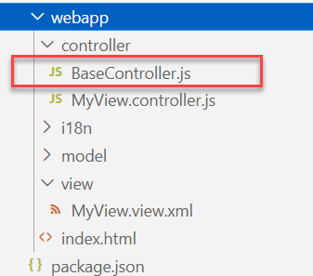
Concept of Base Controller in UI5
Base Controller:- A base controller is a controller with basic functionalities from which the other controllers in your SAPUI5 application inherit.
The base controller holds basic functionalities that are used across multiple controllers.
The base controller itself is just another JavaScript file and it does not have the .controller prefix. Just BaseController.js and not BaseController.controller.js.
The base controller goes in the controller folder in your SAPUI5 application folder structure:
sap/ui/core/mvc/Controller
x
BaseController
Template
x
Controller 1
x
Controller 2
x
Controller 3
x
Controller 4
View 1
View 2
View 3
View 4

Slide 8

Exercise: Base Controller
In this exercise we will create a new BaseController.
Along with that we will see how to load data to a model from a file.
Exercise code/resources: -
MyView.view.xml
MyView.controller.js
BaseController.js

Slide 9
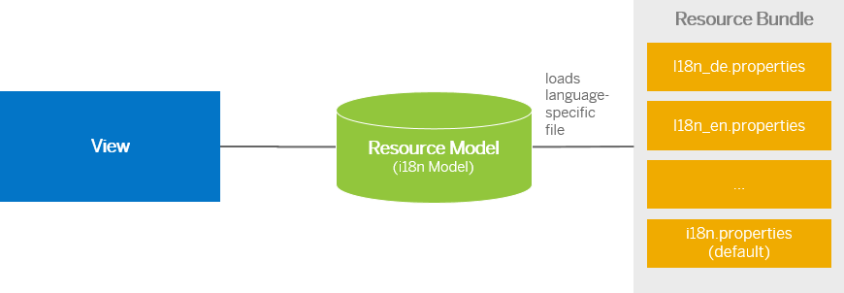
Resource Model
We build software for international audience, we cannot just hardcode every screen element in English, if it requires multi-lingual support, we need to add resource model.
i18n → Internationalization
Create resource bundle which includes label field
The name of the file must be i18n.properties for default labels
And i18n_langcode.properties for different languages
Set The model
For more information about i18n you check the link
https://openui5.hana.ondemand.com/1.34.9/docs/guide/831039835e7c4da3a8a0b49567573afe.html
We can change the language of the app by adding ?sap-language=language_code at the end of the URL of the app. Example for Hindi we will write ?sap-language=hi

Slide 10
Exercise: Resource Model
In this exercise we will see how the language of an app is changed using the i18n file.
We have to create a folder ‘i18n’ in webapps folder and in the folder, we have to add files named ‘i18n.properties’ and one another file named according to the language we want. For example:- for Hindi language the file is named as ‘i18n_hi.properties.
Along with that we will add a delete button on top of the table to delete the record of an employee from the model.
Exercise Code:-
MyView.view.xml
MyView.controller.js
i18n.properties
i18n_hi.properties

Slide 11
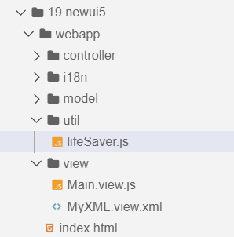
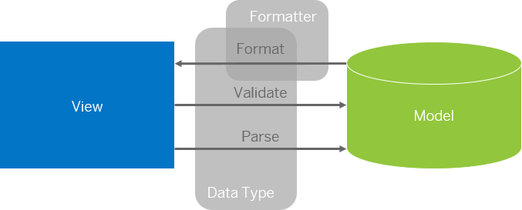
Formatter in SAP UI5
Formatters are used to define the formatting of data on the UI while data types work in both directions: they format the data on the UI and parse and validate user input that is entered.
Formatter is a function; This function gets called JUST Before the binding takes place with the view.
Formatter file is placed in a folder in webapp folder, and the file can be named anything with the .js extension.
Formatter

Slide 12

Exercise: Formatter
In this exercise we are going to currency code in the table.
We will convert the currency code into its corresponding currency symbol.
We will achieve this by using a formatter function.
Exercise Code:-
MyView.view.xml
MyView.controller.js
lifeSaver.js

Slide 13
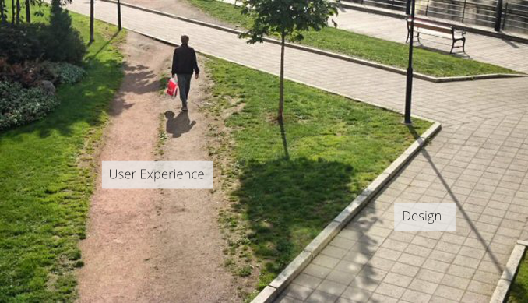
User Experience v/s User Interface
User interface is developer oriented. This is purely technical. We can change UI any number of times.
User experience is user oriented. It is psychological. We cannot change UX.

Slide 14
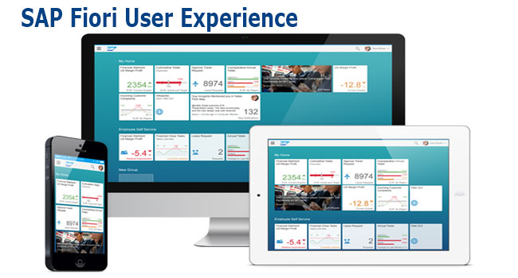
What is Fiori?
SAP Fiori is the user interface or user experience (UX) that supplements and can replace the SAP GUI. This streamlined application uses tiles to encapsulate standard tasks, such as approving purchase requisitions, viewing sales orders, and approving timesheets.
Fiori is SAP’s new user experience. These are standard apps delivered by SAP and by following the Development guidelines any one can use UI5 to create Fiori Apps.
Fiori is a streamlined application, delivering a role-based user experience that can be personalized across all lines of business, tasks and devices.
It uses tiles to encapsulate standard tasks like viewing sales orders or approving timesheets.
Fiori = UI5 + Development/Design Guidelines

Slide 15
Structure of a Fiori project
There are different folders and directory are required for setup project: webapp, Controller, models, utils ,view, Component.js, manifest.json, index.html
Structure of normal ui5 application
Index.html
View
Controller
Structure of Fiori Application
Dev.
sap/ui/core/UIComponent
Index.html
Root View
App.view.xml
Component.js
View 1
Controller 1
Container
App (pages)
View 2
Controller 2
manifest.json
App descriptor
App.controller.js
BaseController
Component.js is starting point

Slide 16
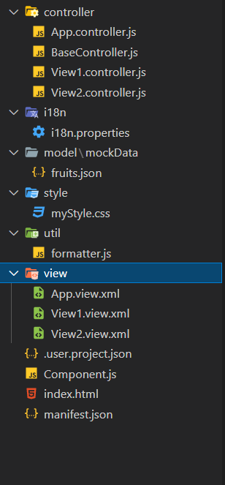
Structure of Fiori Project Files
There are different folders and directory are required for setup project
Webapp = This provides the root directory and of all files given in alias name or namespace
Controller = The controller folder contains all the controllers used by your views and might also contain additional logic files that are used by one or more controllers. The structure of the controller folder should mirror the view folder.
models = It contains .json file and object of data
utils = It is the reuse file of JS code
view = It contains all the .xml files.
Component.js = It is the starting file of our app
manifest.json = It is the application descriptor file.
Index.html

Slide 17
Structure of a Fiori project
There are different folders and directory are required for setup project: webapp, Controller, models, utils ,view, Component.js, manifest.json, index.html
Structure of normal ui5 application
Index.html
View
Controller
Structure of Fiori Application
Dev.
sap/ui/core/UIComponent
Index.html
Root View
App.view.xml
Component.js
View 1
Controller 1
Container
App (pages)
View 2
Controller 2
manifest.json
App descriptor
App.controller.js
BaseController
Component.js is starting point

Slide 18
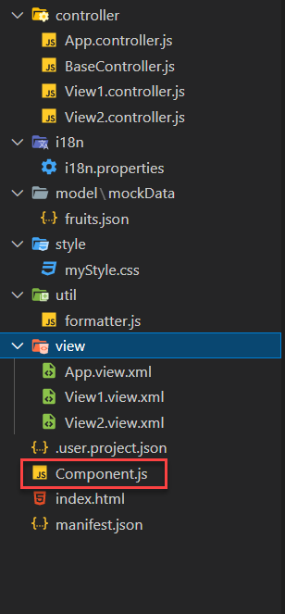
What is Component.js
Component.js the starting point of ANY Fiori app. If an app has Component.js inside, it called Fiori like app.
The Component.js file is the component controller and provides the runtime metadata and the component methods.
It is the wrapper of all the functionality. We never start any productive code in index.html, rather its all kept in Component.js
It is a class which inherits from sap/ui/core/UIComponent standard class. We inherit to reuse the functionality offered by SAP like routing.
When app starts, UI5 framework will scan your project’s base directory to check if it has a file with exact name Component.js
The component file calls the manifest file, and we keep all app level configuration inside the manifest file.
It is also important from the point of view that we will instantiate all models for our application inside the manifest file. The model instantiated in manifest file are directly set on the component and not on the root view.

Slide 19
Skeleton of Component.js
The Component.js is consists of 4 sections
metadata
init()
destroy()
createContent()
The metadata section. It has property key manifest and value json. This property calls the manifest.json file which is also know as the app descriptor file. It holds all app level configuration and helps keep our Component file clean thereby clearly separating application coding from configuration settings.
Another section of component file is the init function that is called when the component is initialized. When the component is instantiated, the init function is automatically invoked.
sap.ui.define([
'sap/ui/core/UIComponent'
], function(UIComponent) {
'use strict';
return UIComponent.extend("anubhav.app.Component",{
metadata: {},
init: function(){
},
createContent: function(){
},
destroy: function(){
}
});
});

Slide 20

Exercise: First Fiori App
In this exercise we will create a new project folder, in that folder we will add new ui5 project with an App view and a View1, and we will add a Component folder in the webapp folder.
Exercise code/resource:
firstfioriapp
webapp
controller
App.controller.js
BaseController.js
View1.controller.js
view
App.view.xml
View1.view.xml
Component.js
index.html
manifest.json

Slide 21
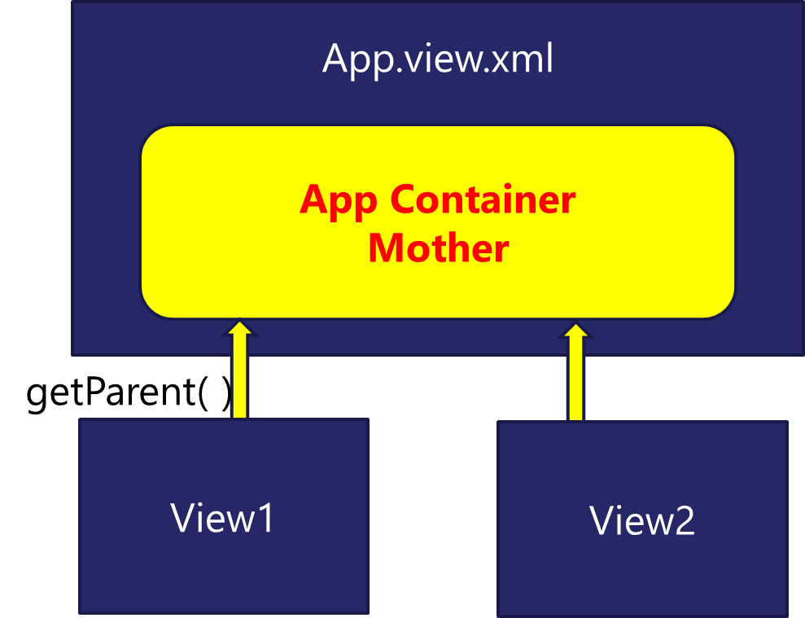
Working with multiple views in Fiori
Most of the Fiori app developed in the industry used to have more than one view. To work with multiple views, we use the concept of Parent View in the Fiori application. Which means all the views are loaded in one Parent View(App View) which then calls the view we want to display to the user.

Slide 22

Exercise: Working with multiple View
In this exercise we will add a New view in our existing application and will add button to our View1 to navigate to the View2.
Exercise code/resource:-
View1.view.xml
View1.controller.js
View2.view.xml
View2.controller.js
Component.js

Slide 23
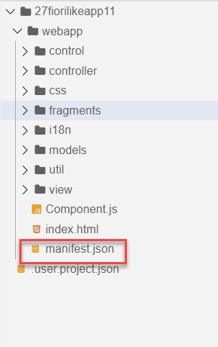
Concept of manifest.json in UI5
manifest.json is also knows as application descriptor file. It contains all the configuration for our app centrally.
Some attributes in the descriptor are just for information purposes, such as the minimum OpenUI5 version (minUI5version), others help external components (for example the SAP Fiori launchpad (FLP)) to integrate the application correctly, but most of the attributes are actually used to configure specific aspects of the app that are needed frequently.
It is written in JavaScript Object Notation (JSON) format.
We recommend that you use the manifest.json file to configure the app settings and put
all important information needed to run the app in there. Using this approach means
you need to write less application code, and you can already access the information
before the app is instantiated.
Everything which is needed for an app to start, load, move, run, configure,
requires is inside manifest.json.

Slide 24
Three Sections of manifest.json
sap.ui5 contains different components
rootView, dependencies, contentDensities, models, routing etc.
sap.ui5
sap.app contains idtype, i18n, applicationVersion, title, description, dataSources.
sap.app
sap.ui contains technology, icons, deviceTypes, supportedThemes
sap.ui

Slide 25

End of Day 8

Slide 26

Questions

Slide 27

Anubhav Oberoy

Slide 28


We’re committed to empower you to be
Most Desirable Resource
through powerful training solutions.
We build the workforce of the future.
250+
Corporate Clients
30,000+
Learners Trained
25000+
Learners Placed
FREE WEBINARS
Sign up for free webinars with industry experts every fortnight!
Enroll Now!
Contact us today!
https://anubhavtrainings.com/

Slide 29




More from AnubhavTrainings.com

Slide 30
Title
Content

